Slide 1
Computer Vision: Looking Back to Look Forward
image source
Svetlana Lazebnik
IRIM Short Course
Spring 2020

Slide 2
Or, this is me asking, “What does it all mean?”

Slide 3
Outline of lectures
Tues. 1/28: Where are we going, where have we been?
Wed. 1/29: Stepping back: What is visual perception?
Thurs. 1/30: History of ideas in recognition – Part I
Tues. 2/4: History of ideas in recognition – Part II – TSRB banquet hall
Wed. 2/5: Emerging trends – or, what should we be working on?
Thurs. 2/6: Ethical issues for computer vision researchers

Slide 4
Today: Where are we going, where have we been?
Image source

Slide 5
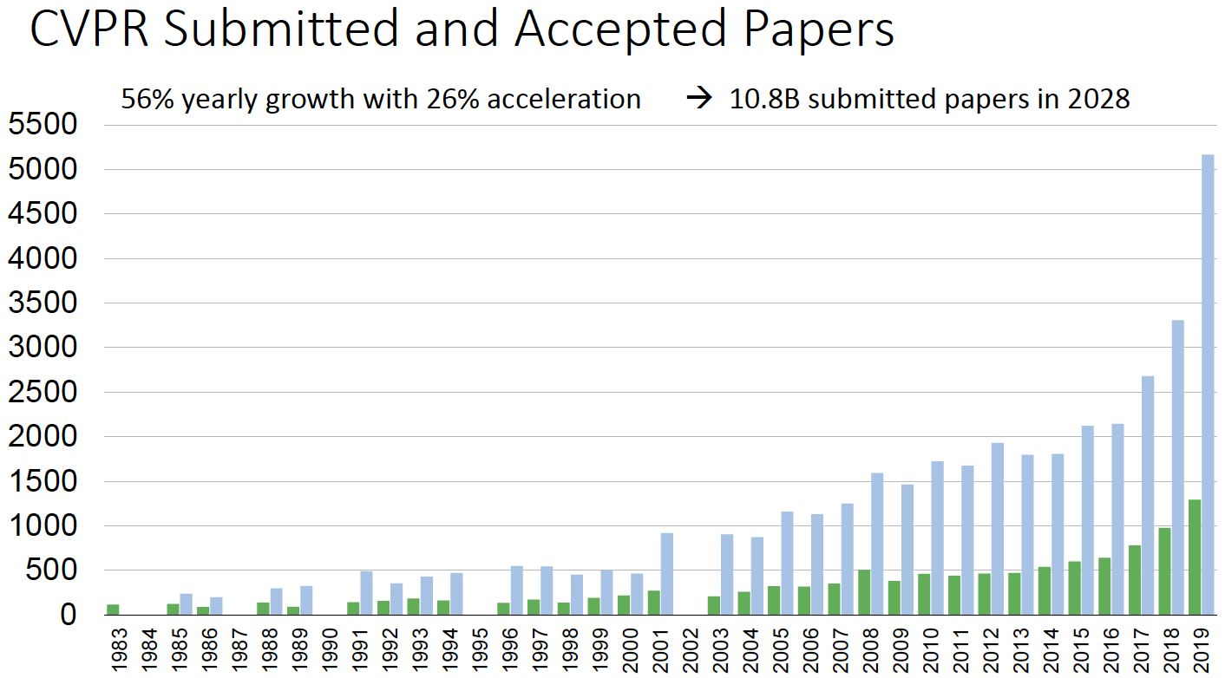
Source: CVPR 2019 opening slides

Slide 6
Fear not: CVPR 2020 received 6655 submissions, “only” 30% over last year’s 5160
Source: CVPR 2019 opening slides

Slide 7
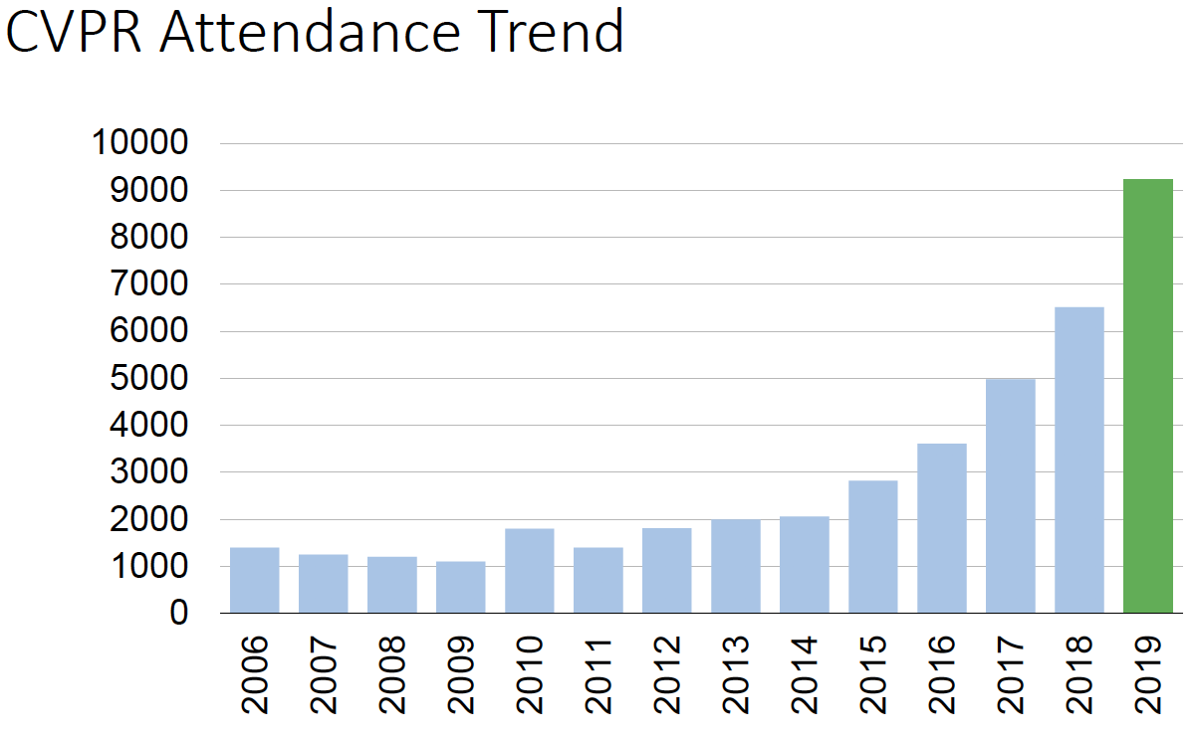
Source: CVPR 2019 opening slides

Slide 8
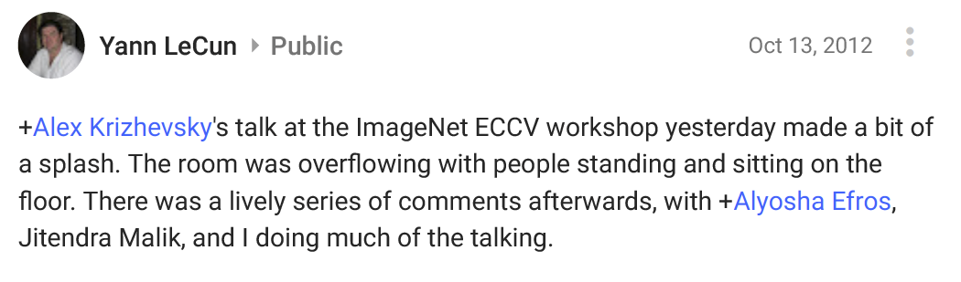
Deep learning “revolution”
AlexNet (2012)
Photo source

Slide 9
Deep learning “revolution”
ImageNet Challenge
Figure source

Slide 10
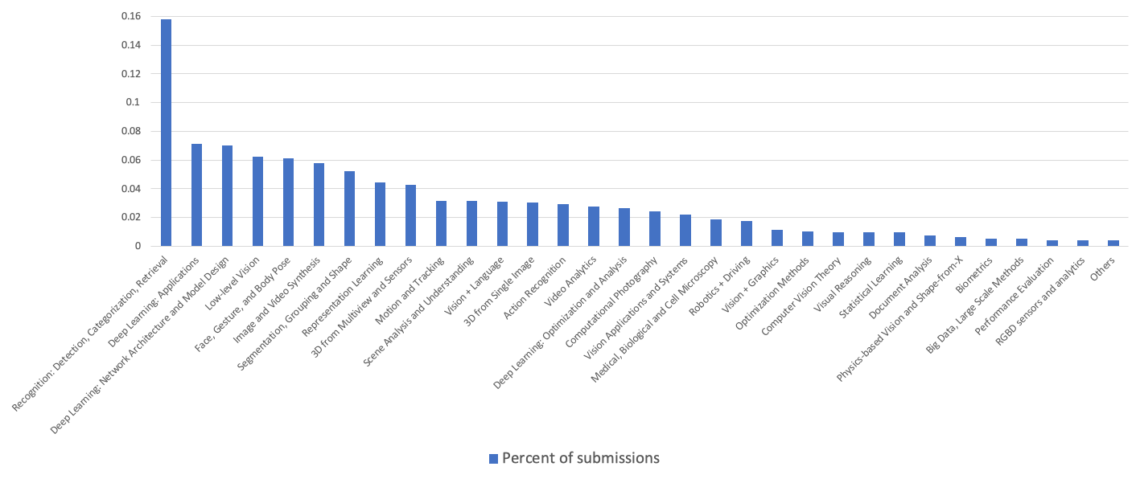
Topic distribution of submissions for ICCV 2019
Not deep learning: <10% of submissions?
Total submissions: 4289

Slide 11
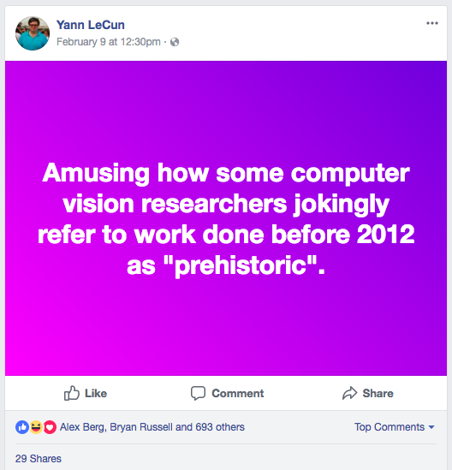
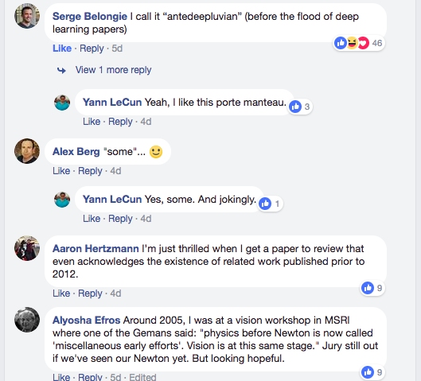
2018

Slide 12
So, what can today’s researchers learn from “prehistoric” computer vision?

Slide 13
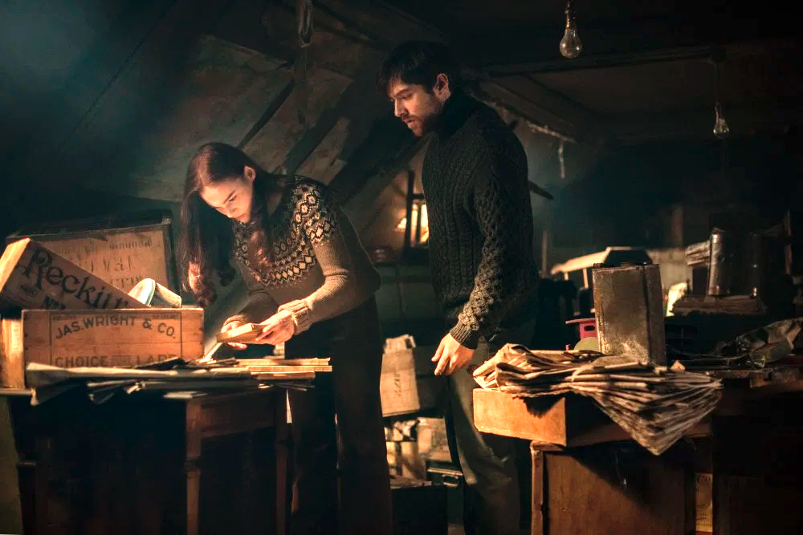
Let’s dig into the history!

Slide 14
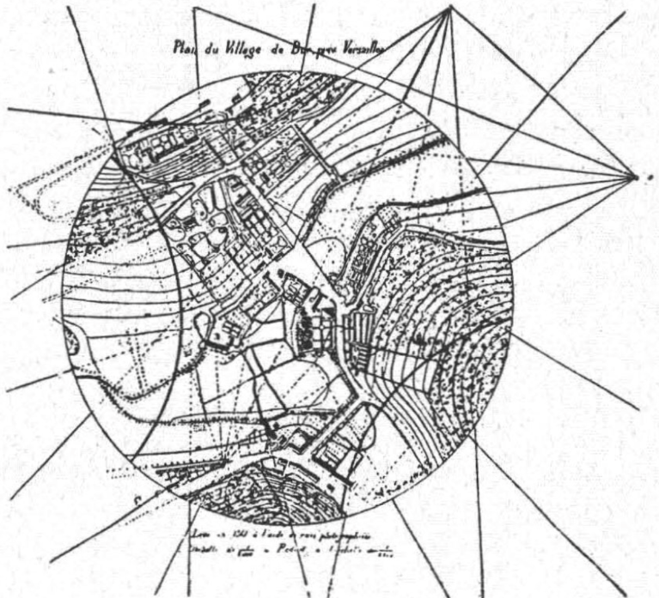
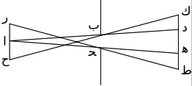
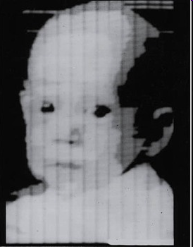
Important “pre-prehistoric” background
Pinhole projection, optics
Projective geometry
Surveying, photogrammetry
Models of color vision (trichromacy)
Early theories of visual perception: Helmholtz, others
Development of cameras, TV, computers, digital imaging

Slide 15
1940s – 1950s: Prelude
1943: McCulloch & Pitts, A Logical Calculus of the Ideas Immanent in Nervous Activity
1948: Wiener, Cybernetics: or Control and Communication in the Animal and the Machine
1949: Hebb, The Organization of Behavior
1950: Turing test
1956: Dartmouth workshop on AI
1957: Digital scanner invented at NIST
1958: Rosenblatt, “The Perceptron: A Probabilistic Model for Information Storage and Organization in the Brain”
1959: Hubel & Wiesel, “Receptive fields of single neurones in the cat’s striate cortex”

Slide 16
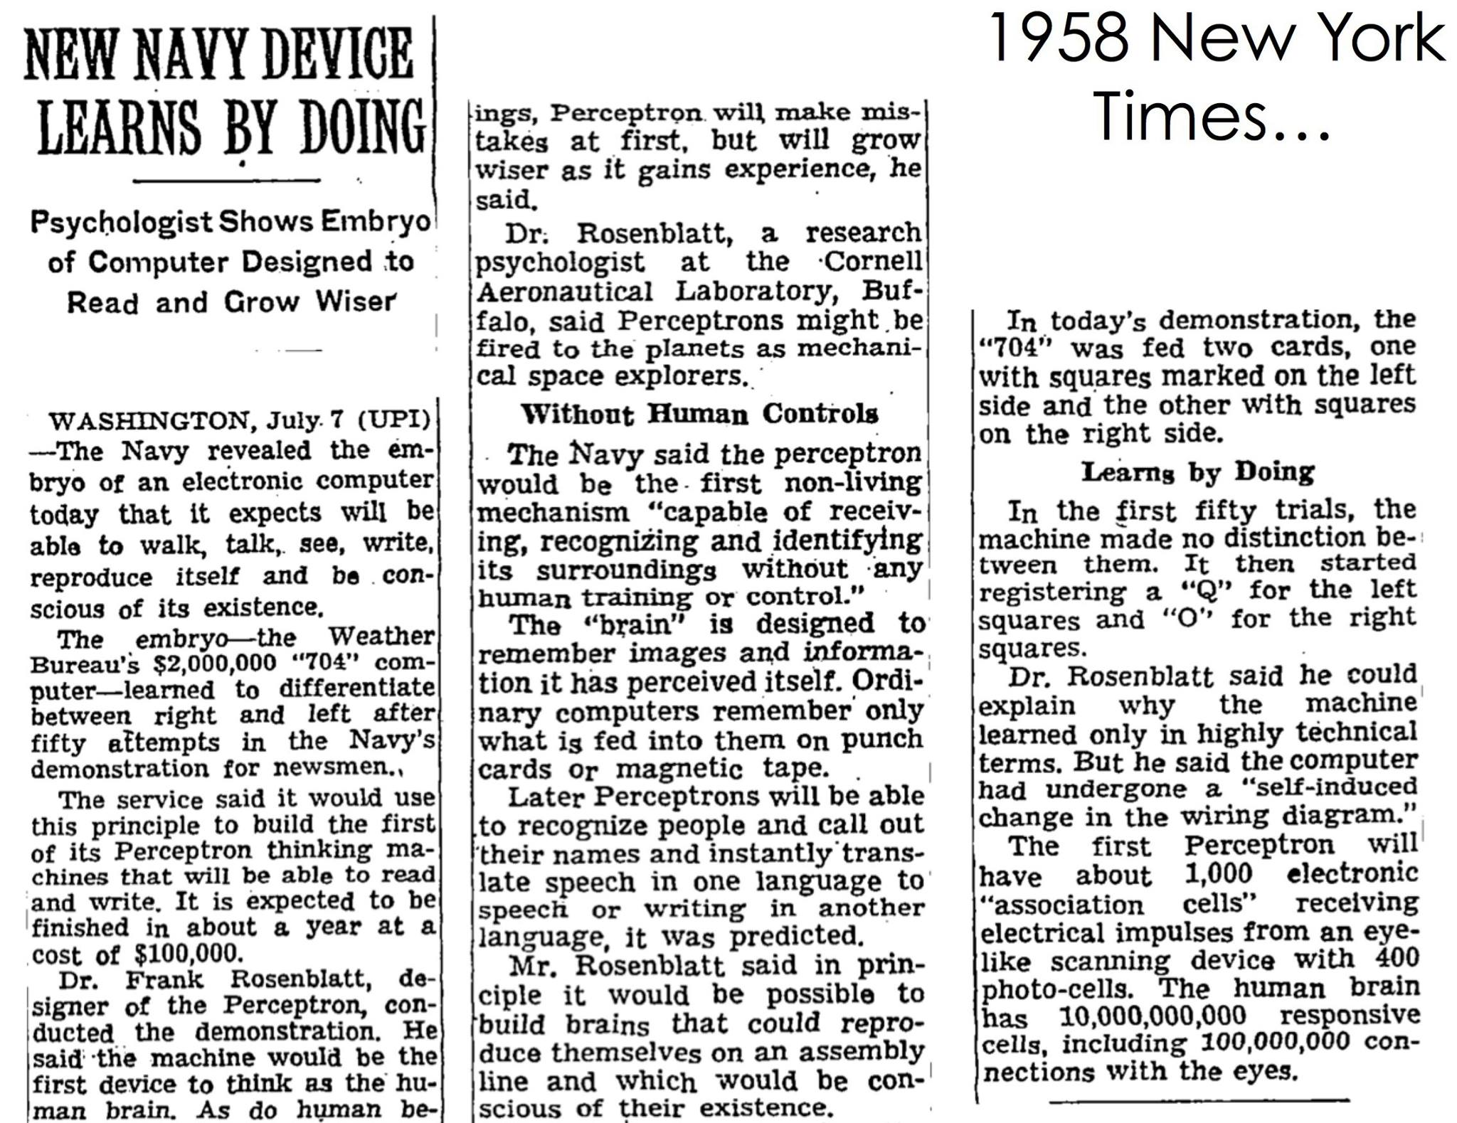
Origins of AI hype?
Frank Rosenblatt (1928-1971)
Notes:
For origins of AI hype, see also: 1954 Georgetown-IBM machine translation experiment

Slide 17
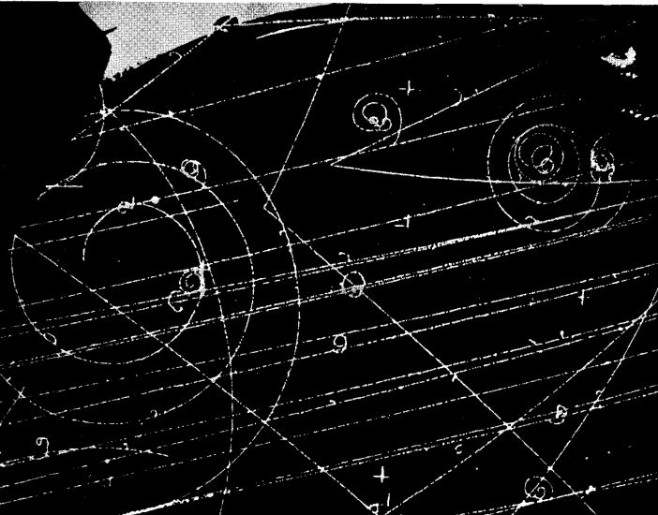
Early applications of image analysis
Character and digit recognition
First OCR conference in 1962
Microscopy, cytology
Interpretation of aerial images
Even before satellites!
Particle physics
Hough transform for analysis of bubble chamber photos published in 1959
Face recognition
Article about W. Bledsoe
Fingerprint recognition

Slide 18
Early applications of image analysis
Character and digit recognition
First OCR conference in 1962
Microscopy, cytology
Interpretation of aerial images
Even before satellites!
Particle physics
Hough transform for analysis of bubble chamber photos published in 1959
Face recognition
Article about W. Bledsoe
Fingerprint recognition
Azriel Rosenfeld (1931-2004)
“Father of computer vision”
Ph.D. in mathematics, Columbia, 1957
Professor at UMD and ordained rabbi
Wrote first textbook in the field in 1969
Oral history (IEEE interview, 1998)

Slide 19
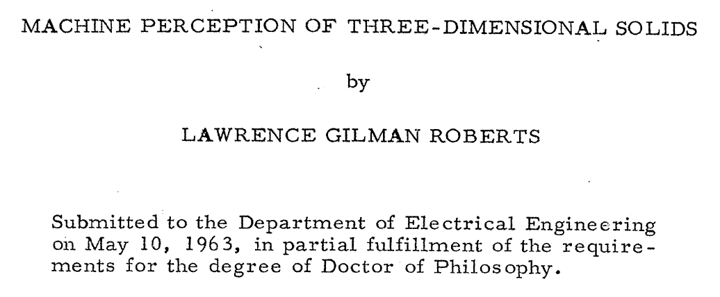
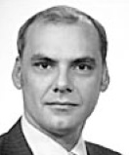
1960s: the MIT-centric narrative
1963: Roberts Ph.D. thesis at MIT
1937– 2018
Wikipedia bio

Slide 20
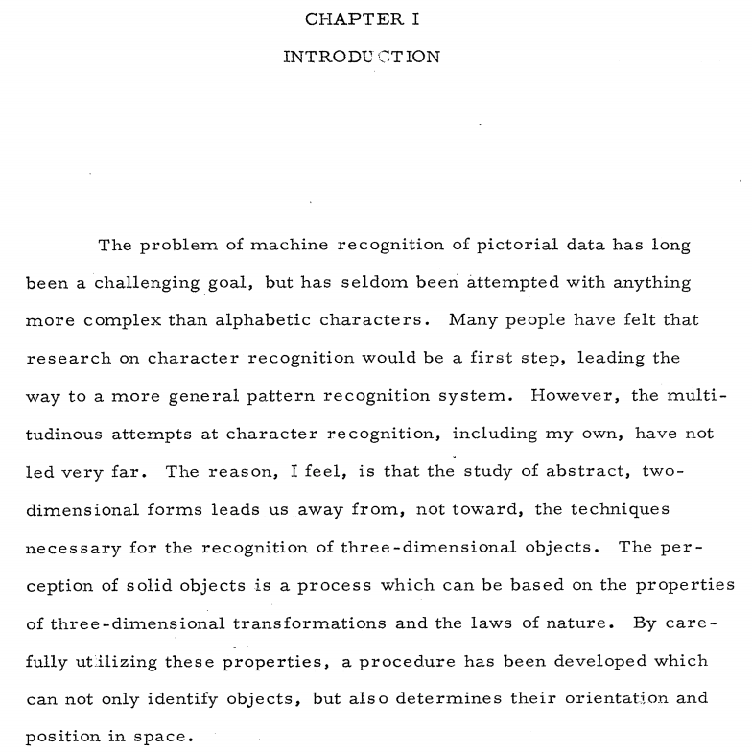

Slide 21
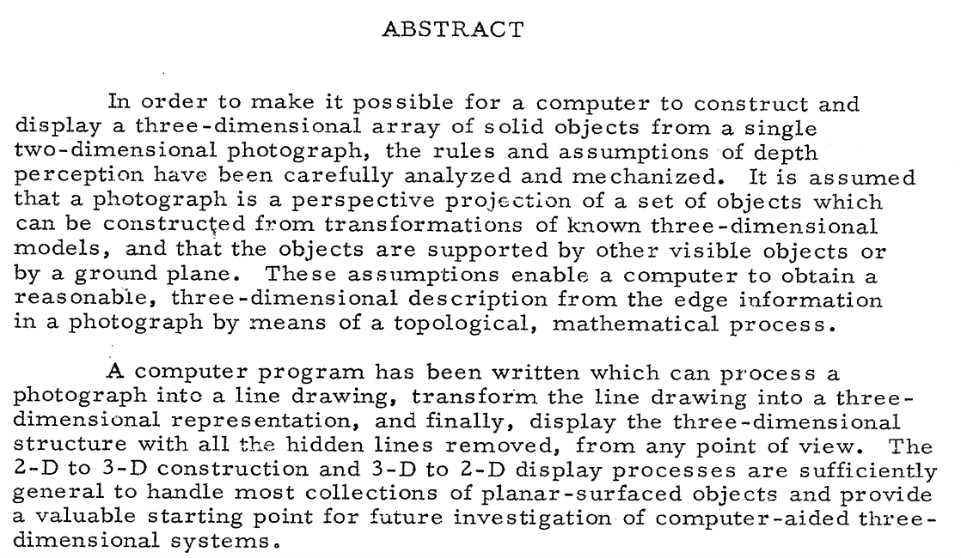

Slide 22
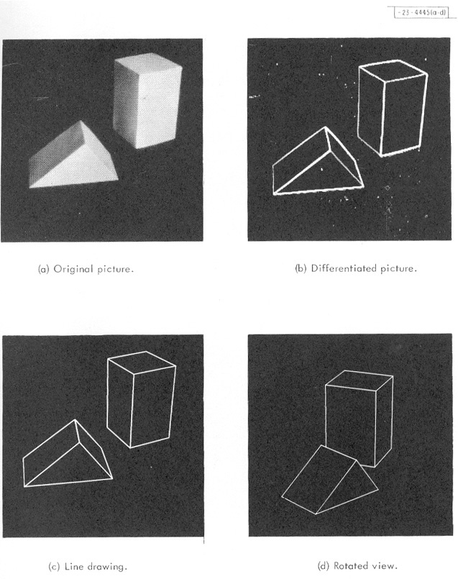
From the abstract:
“It is assumed that a photograph is a projection of… known three-dimensional models… These assumptions enable a computer to obtain a reasonable, three-dimensional description from the edge information in a photograph by means of a topological, mathematical process.”

Slide 23
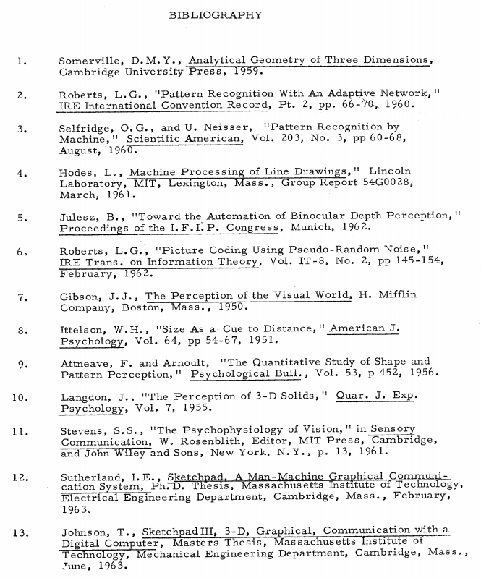

Slide 24
1960s: the MIT-centric narrative
1963: Roberts Ph.D. thesis at MIT
“Computer vision” explicitly defined in opposition to “pattern recognition” – the key is interpreting images as projections of 3D scenes, not flat 2D “patterns”
1966: MIT Summer Vision Project led by Seymour Papert

Slide 25
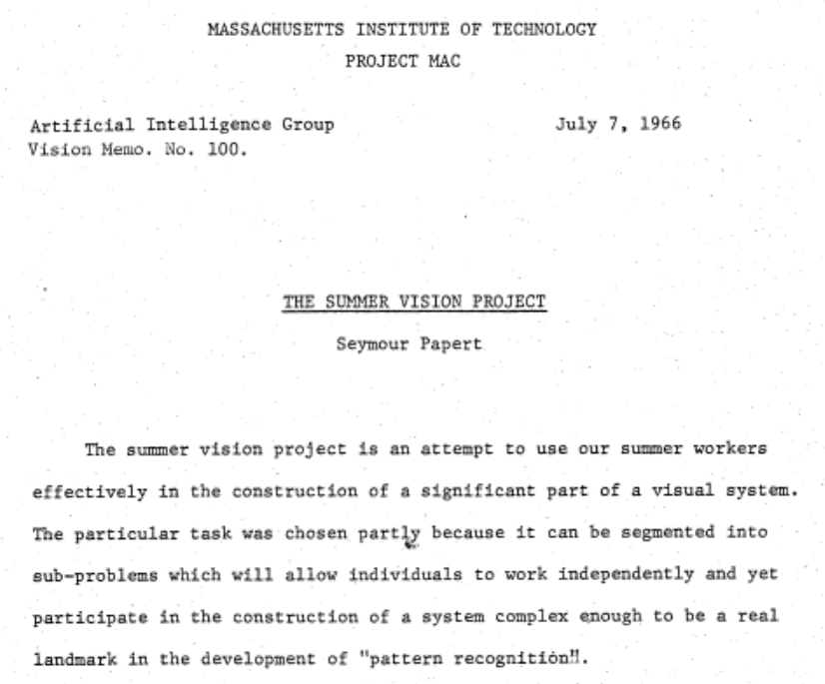

Slide 26
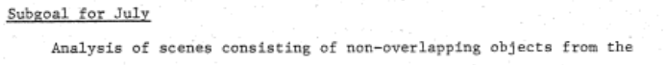
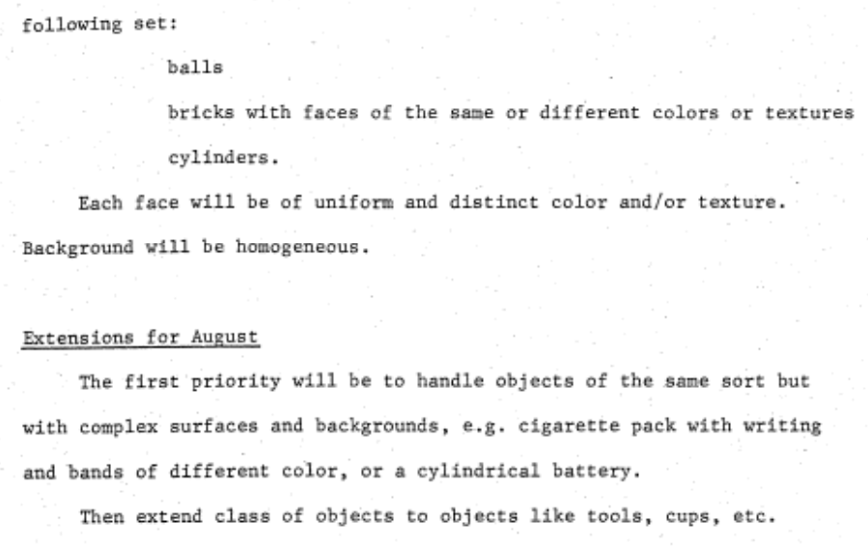

Slide 27
1960s: the MIT-centric narrative
From the beginning, “computer vision” explicitly defined itself in opposition to “pattern recognition.” Key distinction was interest in interpreting images as projections of 3D scenes, not 2D arrays of flat “patterns.”
3D representation and reconstruction became the paramount problems. It was implicitly assumed that solving them must precede recognition.
Because representing general 3D objects was way too hard, “blocks world” became the focus.
Image intensities were discarded at the earliest possible stage and processing concentrated on edge or line features.

Slide 28
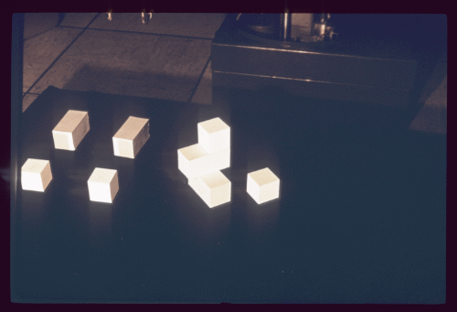
1960s: the MIT-centric narrative
1963: Roberts Ph.D. thesis at MIT
“Computer vision” explicitly defined in opposition to “pattern recognition” – the key is interpreting images as projections of 3D scenes, not flat 2D “patterns”
1966: MIT Summer Vision Project led by Seymour Papert
Underestimated the challenge of computer vision, committed to “blocks world”
1970: MIT copy demo (video)

Slide 29
1960s: the MIT-centric narrative
wouldn’t be complete without…
1969: Minsky and Papert, Perceptrons
Fascinating reading: M. Olazaran, A Sociological Study of the Official History of the Perceptrons Controversy, Social Studies of Science, 1996

Slide 30
Meanwhile: Blocks world and pattern recognition on the West Coast
Shakey the Robot
SRI, 1966 - 1972
Video
Published in 1972 (table of contents)
Notes:
Nearest neighbors: Cover & Hart, 1967
Hough transform: Duda & Hart, 1972

Slide 31
A. Rosenfeld, Picture Processing by Computer, 1969
Pictures as information sources and their efficient encoding
Approximation of pictures - sampling and quantization techniques;
Position-invariant operations on pictures and their implementation (digital, electro-optical, optical); applications to matched filtering (template matching), spatial frequency filtering and image restoration, measurement of image quality, and image enhancement ('smoothing' and 'sharpening’);
Picture properties (linear; local and 'textural'; random) useful for pictorial pattern recognition;
'Figure extraction' from pictures; figure properties (topology, size, shape);
Picture description and 'picture languages.'

Slide 32
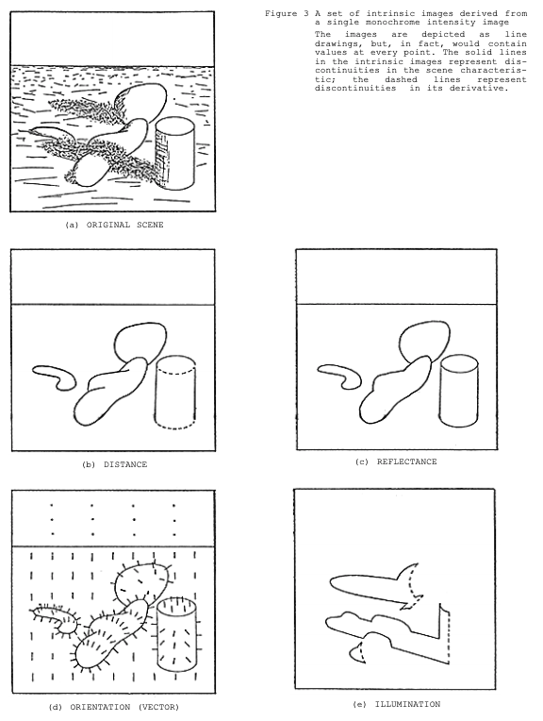
1970s: Recovery
Shape-from-X
Shading: Horn (1970)
Contour: Guzman (1971), Waltz (1975), etc.
Texture: Bajczy & Lieberman (1976)
Stereo: Marr & Poggio (1976)
Color constancy: Land & McCann (1971)
Intrinsic images: Barrow & Tenenbaum (1978)
Range images
Time-varying images
Optical flow, structure from motion
Koenderink & Van Doorn (1975), Ullman (1977)
Barrow & Tenenbaum (1978)

Slide 33
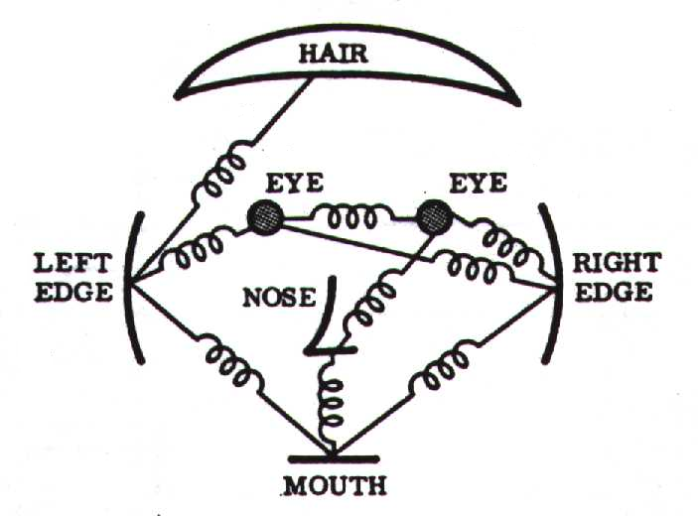
1970s: Representation and recognition
3D shape representation
Generalized cylinders: Binford et al. (1971, etc.)
Deformable templates: Fischler & Elschlager (1973)
Syntactic/procedural recognition systems
Faces: Kanade (1973)
Scenes: Yakimovsky & Feldman (1973), Hanson & Riseman (1978), Ohta & Kanade (1978)
Objects: Brooks (1979)
Relaxation labeling: Rosenfeld et al. (1976)
Texture recognition: Julesz (1960-1981), Haralick (1979), etc.
Pattern recognition
Duda & Hart textbook (1973), ICPR starts in 1973, TPAMI starts in 1979
Fischler & Elschlager (1973)

Slide 34
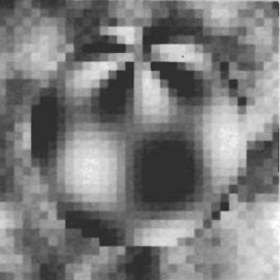
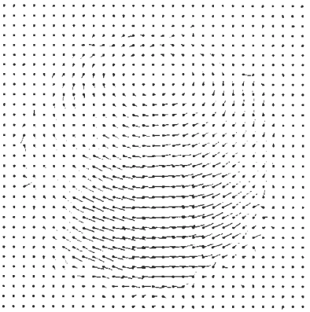
1980s: Progress on many fronts
Optical flow and tracking
Horn & Schunck (1981), Lucas & Kanade (1981), etc.
“Definitive” detectors
Edges: Canny (1986)
Corners: Harris & Stephens (1988)
Structure from motion
RANSAC: Fischler & Bolles (1981)
Essential matrix: Longuet-Higgins (1981)
Markov Random Field models: Geman & Geman (1984)
Image pyramids
Witkin (1983), Burt & Adelson (1984), Koenderink (1984), etc.
Segmentation by energy minimization
Kass, Witkin & Terzopoulos (1987), Mumford & Shah (1989)
Active vision
Bajczy (1985, 1988), Dickmanns (1988), Ballard (1989), etc.
Horn & Schunck (1981)

Slide 35
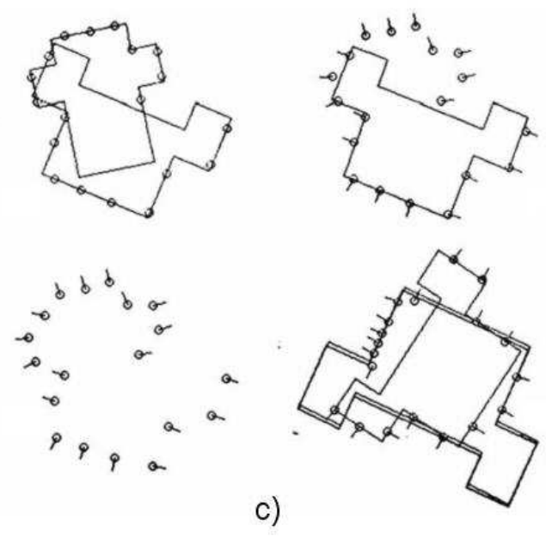
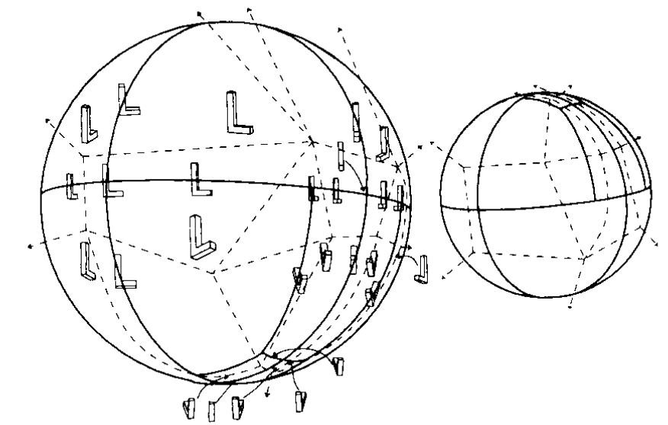
1980s: The dead ends
Alignment-based recognition
Faugeras & Hebert (1983), Grimson & Lozano-Perez (1984), Lowe (1985), Huttenlocher & Ullman (1987), etc.
Aspect graphs
Koenderink & Van Doorn (1979), Plantinga & Dyer (1986), Hebert & Kanade (1985), Ikeuchi & Kanade (1988), Gigus & Malik (1990)
Invariants: Mundy & Zisserman (1992)
Grimson & Lozano-Perez (1984)
Gigus & Malik (1990)

Slide 36
1980s: Milestones
1983: First CVPR
1987: First ICCV, IJCV
Books: Marr (1982), Ballard & Brown (1982), Horn (1986)

Slide 37
1980s: Meanwhile…
Neocognitron: Fukushima (1980)
Video (short version)
Back-propagation: Rumelhart, Hinton & Williams (1986)
Origins in control theory and optimization: Kelley (1960), Dreyfus (1962), Bryson & Ho (1969), Linnainmaa (1970)
Application to neural networks: Werbos (1974)
Parallel Distributed Processing: Rumelhart et al. (1987)
Neural networks for digit recognition: LeCun et al. (1989)
Fukushima (1980)

Slide 38
1990s: Geometry reigns
Fundamental matrix: Faugeras (1992)
Normalized 8-point algorithm: Hartley (1997)
RANSAC for robust fundamental matrix estimation: Torr & Murray (1997)
Bundle adjustment: Triggs et al. (1999)
Hartley & Zisserman book (2000)
Projective structure from motion: Faugeras and Luong (2001)

Slide 39
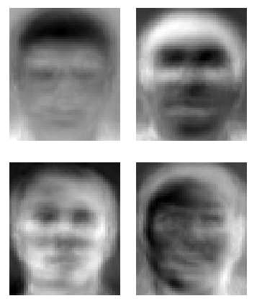
1990s: Data enters the scene
Appearance-based models: Turk & Pentland (1991), Murase & Nayar (1995)
Keypoint-based image indexing
Schmid & Mohr (1996), Lowe (1999)
Constellation models for object categories
Burl, Weber & Perona (1998), Weber, Welling & Perona (2000)
First sustained use of classifiers and negative data
Face detectors: Rowley, Baluja & Kanade (1996), Osuna, Freund & Girosi (1997), Schneiderman & Kanade (1998), Viola & Jones (2001)
Convolutional nets: LeCun et al. (1998)
Segmentation
Graph cuts: Boykov, Veksler & Zabih (1998)
Normalized cuts: Shi & Malik (2000)
Berkeley segmentation dataset: Martin et al. (2001)
Optical flow
Adelson & Wang (1993), Black & Anandan (1993)
Tracking of complicated shapes
Bregler & Malik (1998), Stauffer & Grimson (1998), Isard & Blake (1998), Comaniciu et al. (2000), Sidenbladh et al. (2000)
Turk & Pentland (1991)

Slide 40
Late 1990’s debates
See the last chapter of Vision Algorithms: Theory and Practice (1999)

Slide 41
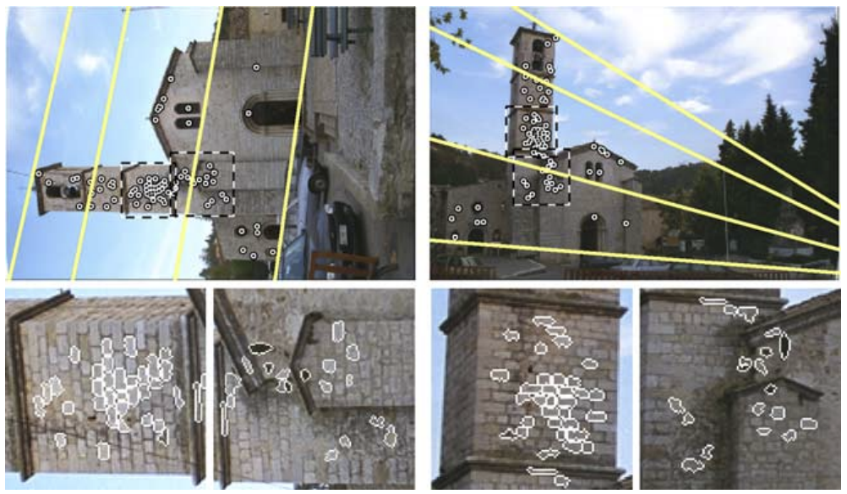
2000s: The era of features
Keypoints craze
Kadir & Brady (2001), Mikolajczyk & Schmid (2002), Matas et al. (2002), Bay et al. (2006), etc.
3D reconstruction gets “solved”
SFM in the wild
Multi-view stereo, stereo on GPU’s
Generic object recognition
Constellation models, graphical models craze
Bags of features
Datasets: Caltech-101, PASCAL, ImageNet
Generic object detection
PASCAL dataset
HOG, Deformable part models
Action and activity recognition – “misc. early efforts”
Matas et al. (2002)

Slide 42
Six decades of computer vision: Reductive summary
1960s and 70s: The “early years”
Community gets over its blocks world phase
Canonical recovery problems are defined and initial approaches are proposed
Ambitious scene understanding approaches flower briefly and prematurely
Marr’s book sums up progress to date
1980s and 90s: The “middle ages”
The field goes through its geometric recognition phase and gets over irrelevant geometric obsessions
Multi-view geometry matures and becomes useful, as summarized in the Hartley & Zisserman book
The field stops being afraid of pixels and discovers data and classifiers
2000s and 2010s: The early modern era?
Local features “solve” structure from motion and instance recognition
Generic category recognition and detection become central problems
The field becomes driven by datasets and benchmarks

Slide 43
What did I omit?
Image filtering
Wavelets, steerable filters, bilateral filtering…
Biologically inspired low-level representations (Olhausen & Field, etc.)
Generation methods
E.g., texture generation (Heeger & Bergen, Efros & Leung, etc.)
Image-based modeling and computational photography
Dense reconstruction
Probabilistic and graphical models (on purpose)
Perceptual organization (on purpose)

Slide 44
Where did we go wrong?
In retrospect, computer vision has had several periods of “spinning its wheels”
We’ve always prioritized methods that could already do interesting things over potentially more promising methods that could not yet deliver
We’ve undervalued simple methods, data, and learning
When nothing worked, we distracted ourselves with fancy math
On a few occasions, we unaccountably ignored methods that later proved to be “game changers” (RANSAC, SIFT)
We’ve had some problems with bandwagon jumping and intellectual snobbery
But it’s not clear whether any of it mattered in the end…

Slide 45
Lana’s MVP’s (Most Valuable Papers)
Hough transform – Duda & Hart, 1972
Pictorial structures – Fischler & Elschlager, 1973
RANSAC – Fischler & Bolles, 1981
Edge detection – Canny, 1986
Corner detection – Harris & Stephens, 1988
Normalized 8-point algorithm – Hartley, 1997
Graph cuts – Boykov et al., 2001
Face detection with boosting – Viola & Jones, 2001
SIFT – Lowe, 2004
Deformable part models – Felzenszwalb et al., 2010

Slide 46
Further reading
Azriel Rosenfeld interview (1998)
Rosenfeld survey (1998)
Computer vision: the last 50 years by Linda Shapiro
Rick Szeliski book (history in sec. 1.2)
Computer vision awards
Serge Belongie’s Top 10 PAMI articles

